Slide 1

CSCI E-25 Computer Vision
Stereogeometry and 3-D Computer Vision
Steve Elston
Copyright 2022, 2023, Stephen F Elston. All rights reserved.

Slide 2
3-D Computer Vision
Stereography and 3-D CV algorithms attempt to construct 3-D models of the real world
3-D CV uses two or more camera poses to create 3-D models
3-D CV has many applications:
Autonomous vehicles
Robotics
Augmented reality
Scanning 3-D shapes of real objects
Etc…
3-D CV is slowly seeing the impact of deep NN models

Slide 3
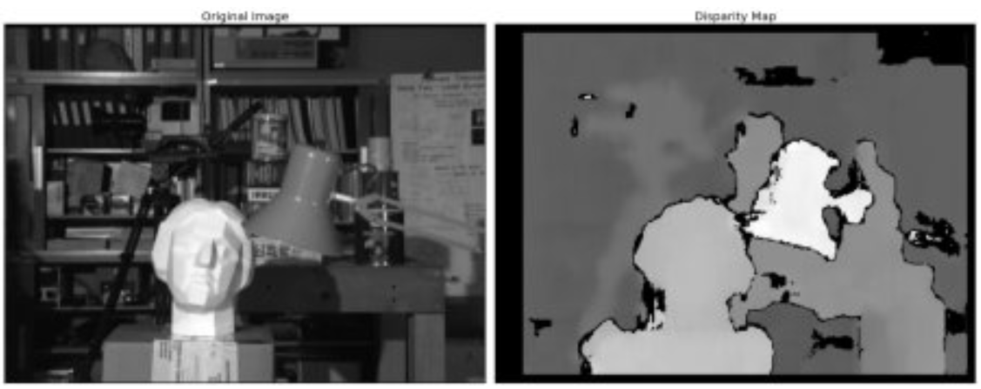
3-D Computer Vision
Example: Depth map of room scene from stereo camera pair
From: https://docs.opencv.org/4.x/dd/d53/tutorial_py_depthmap.html

Slide 4
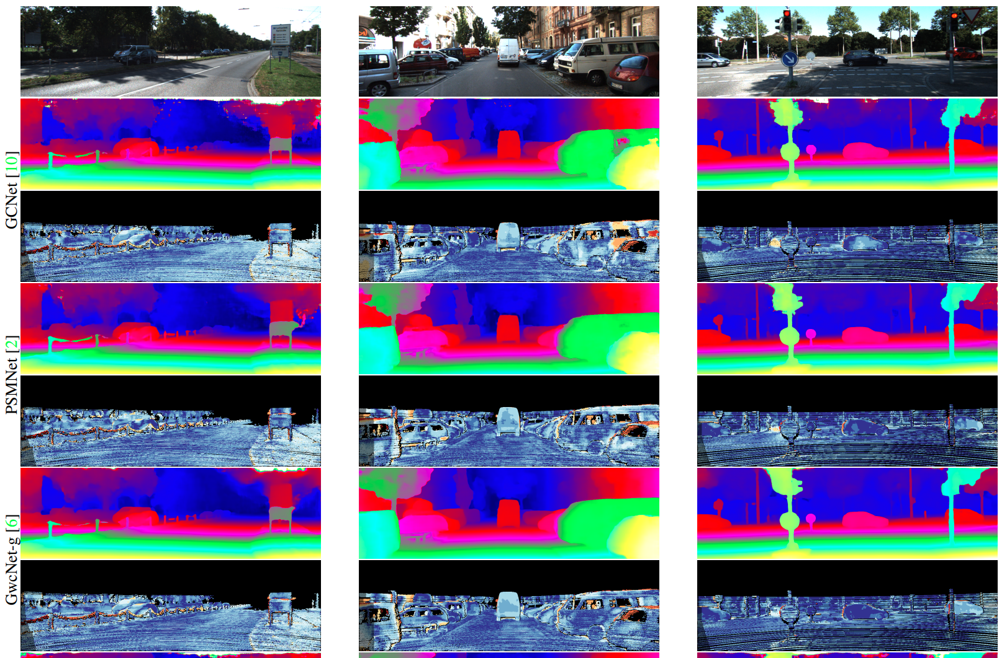
3-D Computer Vision
Example: Depth maps for autonomous vehicle navigation
From: Shamsafar, et. al., 2021

Slide 5
3-D Computer Vision
Overview of lesson
What methods can we use for 3-D CV models?
Epipolar geometry
Properties of the essential matrix
Solving for the fundamental matrix
Stereo depth estimation
Rectification of images

Slide 6
3-D Computer Vision
Approaches to 3-D CV
Direct sensing
Radar
Lidar
Moving camera or object
Extension of optical flow
See for details
Multiple camera poses
Use 2 or more camera poses
Solve inverse projection problem
We focus on 2 camera case

Slide 7
Stereo Vision Problem
Stereo vision is a canonical problem in computer vision
Can locate a point in 3-D space from location on 2 or more image planes
Solving this problem requires a model for the cameras
Solve system of model equations to locate point in 3-D space
w
Image plane 1
Image plane 2
x₁
x₂
Optical center 1
Optical center 2

Slide 8

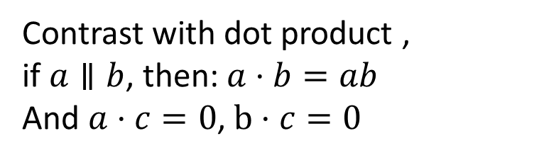
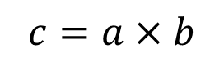

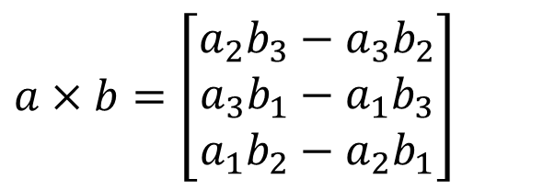
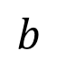
Linear Algebra Review: Vector Cross Product
The vector cross product is essential to solving 3-D projection problem
Cross product of two vectors is perpendicular to both vectors
$$c=a×b$$
$$a×b=\left[\begin{matrix}a_{2}b_{3}−a_{3}b_{2} \\ a_{3}b_{1}−a_{1}b_{3} \\ a_{1}b_{2}−a_{2}b_{1}\end{matrix}\right]$$
If $a∥b$, then: $a×b=0$
$$b$$
Contrast with dot product ,
if $a∥b$, then: $a⋅b=ab$
And $a⋅c=0$, $b⋅c=0$
$$a$$

Slide 9
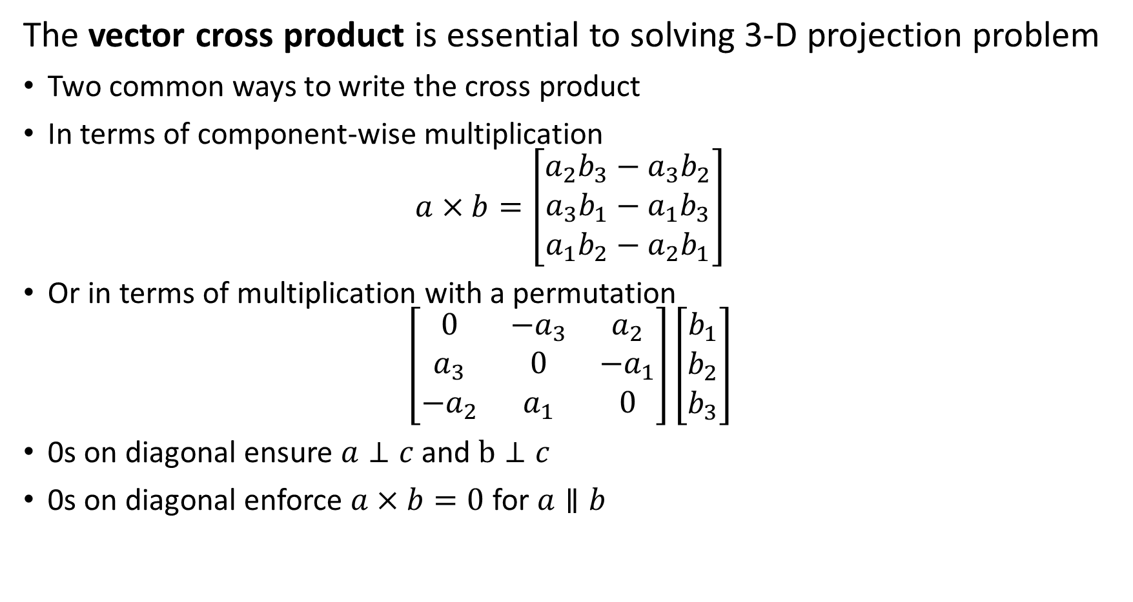
Linear Algebra Review: Vector Cross Product
The vector cross product is essential to solving 3-D projection problem
Two common ways to write the cross product
In terms of component-wise multiplication
$$a×b=\left[\begin{matrix}a_{2}b_{3}−a_{3}b_{2} \\ a_{3}b_{1}−a_{1}b_{3} \\ a_{1}b_{2}−a_{2}b_{1}\end{matrix}\right]$$
Or in terms of multiplication with a permutation
$$\left[\begin{matrix}0 & −a_{3} & a_{2} \\ a_{3} & 0 & −a_{1} \\ −a_{2} & a_{1} & 0\end{matrix}\right]\left[\begin{matrix}b_{1} \\ b_{2} \\ b_{3}\end{matrix}\right]$$
0s on diagonal ensure $a⊥c$ and $b⊥c$
0s on diagonal enforce $a×b=0$ for $a∥b$

Slide 10
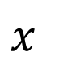
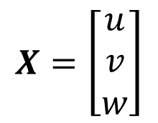


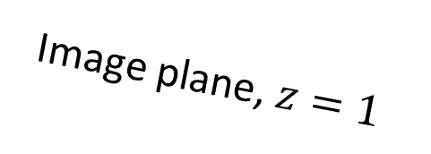
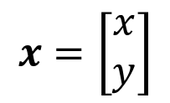
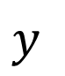
Review: Pinhole Camera Model
Homogeneous coordinates for a pinhole camera model
Image plane, $z=1$
$$X=\left[\begin{matrix}u \\ v \\ w\end{matrix}\right]$$
Pinhole at origin
$$x=\left[\begin{matrix}x \\ y\end{matrix}\right]$$
O
$$z$$
Principle Point
Optic Axis
$$x$$
$$y$$
$$φ=1$$

Slide 11
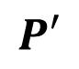
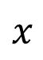


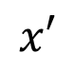
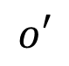

Epipolar Geometry
Epipolar geometry is the basis for 3-D image construction
Start with a point in space X
Point projected, with camera matrix P, at point x on image plane of camera 1 with optical center o
Point projected, with camera matrix P’, at point x’ on image plane of camera 2 with optic center o’
$$X$$
$$P$$
$$P′$$
$$x$$
$$x′$$
$$o$$
$$o′$$

Slide 12
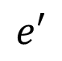
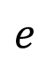
Epipolar Geometry
Epipolar geometry is the basis for 3-D image construction
Start with two camera poses
Baseline connects optic centers of cameras
Baseline crosses the image planes at the epipodes, e, e’
The points X, o, and o’ define the epipolar plane
$$X$$
$$P$$
$$P′$$
$$x$$
$$x′$$
$$o$$
$$e$$
$$e′$$
$$o′$$

Slide 13
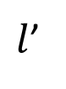
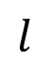
Epipolar Geometry
Epipolar geometry is the basis for 3-D image construction
Start with two camera poses
Epipolar lines connect epipodes, e, e’ to x, x’
Epipolar lines lie in the epipolar plane
$$X$$
$$P$$
$$P′$$
$$x$$
$$x′$$
$$l$$
$l$’
$$o$$
$$e$$
$$e′$$
$$o′$$

Slide 14
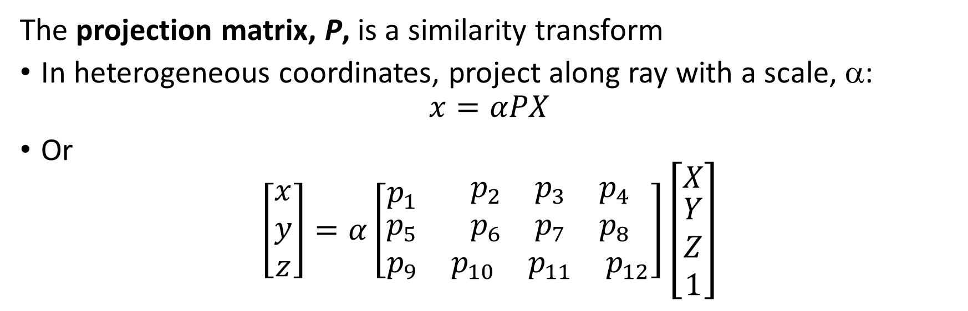
Projections to Camera Coordinates
The projection matrix, P, is a similarity transform
In heterogeneous coordinates, project along ray with a scale, α:
$$x=αPX$$
Or
$$\left[\begin{matrix}x \\ y \\ z\end{matrix}\right]=α\left[\begin{matrix}p_{1} & \begin{matrix}p_{2} & p_{3} & p_{4}\end{matrix} \\ \begin{matrix}p_{5} \\ p_{9}\end{matrix} & \begin{matrix}\begin{matrix}p_{6} & p_{7} & p_{8}\end{matrix} \\ \begin{matrix}p_{10} & p_{11} & p_{12}\end{matrix}\end{matrix}\end{matrix}\right]\left[\begin{matrix}X \\ \begin{matrix}Y \\ Z \\ 1\end{matrix}\end{matrix}\right]$$
$$X$$
$$P$$
$$P′$$
$$x$$
$$x′$$
$$l$$
$l$’
$$o$$
$$e$$
$$e′$$
$$o′$$

Slide 15
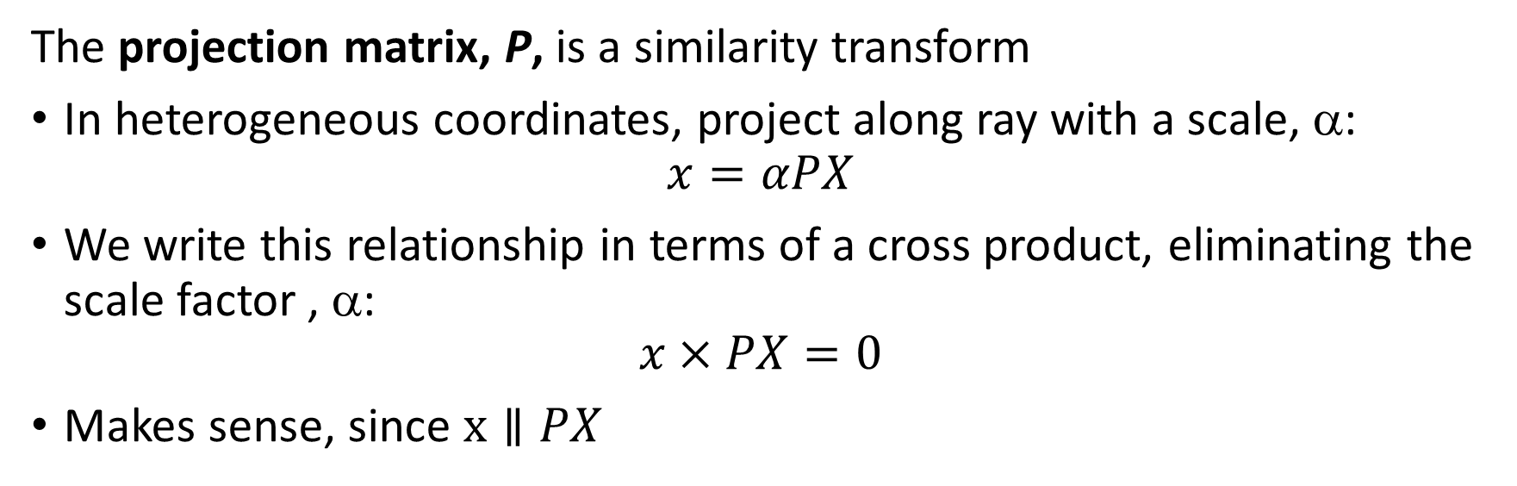
Projections to Camera Coordinates
The projection matrix, P, is a similarity transform
In heterogeneous coordinates, project along ray with a scale, α:
$$x=αPX$$
We write this relationship in terms of a cross product, eliminating the scale factor , α:
$$x×PX=0$$
Makes sense, since $x∥PX$
$$X$$
$$P$$
$$P′$$
$$x$$
$$x′$$
$$l$$
$l$’
$$o$$
$$e$$
$$e′$$
$$o′$$

Slide 16
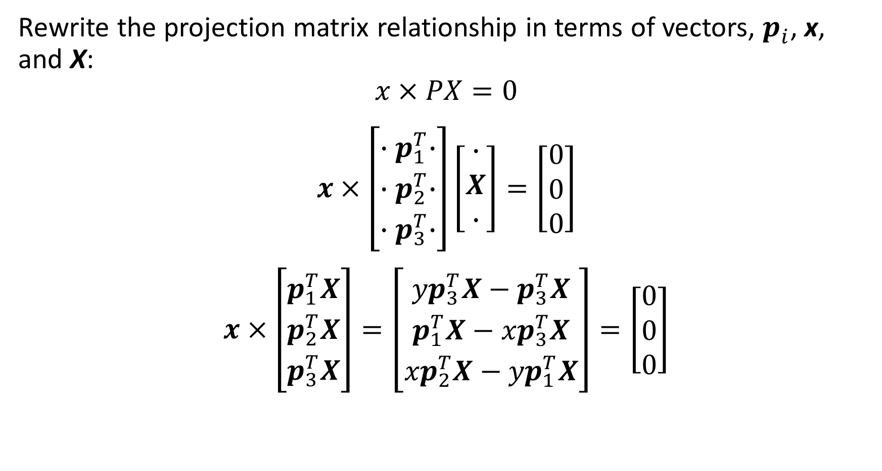
3-D Computer Vision
Rewrite the projection matrix relationship in terms of vectors, $p_{i}^{ }$, x, and X:
$$x×PX=0$$
$$x×\left[\begin{matrix}{∙p}_{1}^{T}∙ \\ {∙p}_{2}^{T}∙ \\ {∙p}_{3}^{T}∙\end{matrix}\right]\left[\begin{matrix}∙ \\ X \\ ∙\end{matrix}\right]=\left[\begin{matrix}0 \\ 0 \\ 0\end{matrix}\right]$$
$$x×\left[\begin{matrix}p_{1}^{T}X \\ p_{2}^{T}X \\ p_{3}^{T}X\end{matrix}\right]=\left[\begin{matrix}{{yp}_{3}^{T}X−p}_{3}^{T}X \\ {p_{1}^{T}X−xp}_{3}^{T}X \\ {{xp}_{2}^{T}X−yp}_{1}^{T}X\end{matrix}\right]=\left[\begin{matrix}0 \\ 0 \\ 0\end{matrix}\right]$$

Slide 17
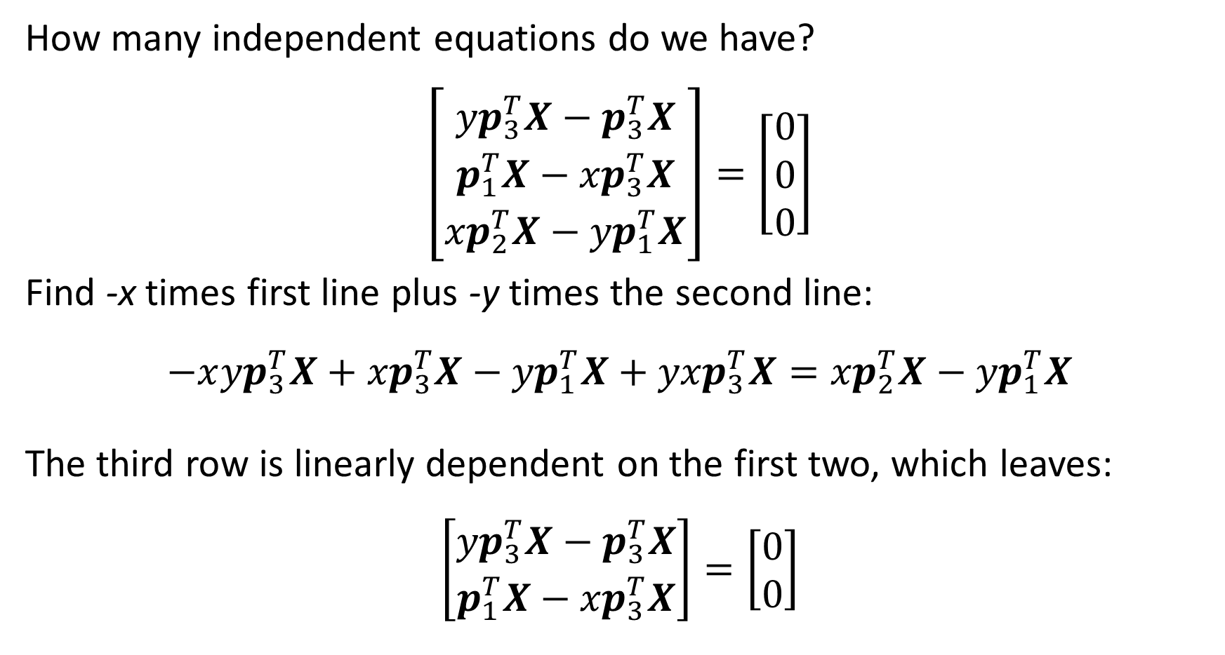
3-D Computer Vision
How many independent equations do we have?
$$\left[\begin{matrix}{{yp}_{3}^{T}X−p}_{3}^{T}X \\ {p_{1}^{T}X−xp}_{3}^{T}X \\ {{xp}_{2}^{T}X−yp}_{1}^{T}X\end{matrix}\right]=\left[\begin{matrix}0 \\ 0 \\ 0\end{matrix}\right]$$
Find -x times first line plus -y times the second line:
$$−x{{yp}_{3}^{T}X+xp}_{3}^{T}X−{{yp}_{1}^{T}X+yxp}_{3}^{T}X={{xp}_{2}^{T}X−yp}_{1}^{T}X$$
The third row is linearly dependent on the first two, which leaves:
$$\left[\begin{matrix}{{yp}_{3}^{T}X−p}_{3}^{T}X \\ {p_{1}^{T}X−xp}_{3}^{T}X\end{matrix}\right]=\left[\begin{matrix}0 \\ 0\end{matrix}\right]$$

Slide 18
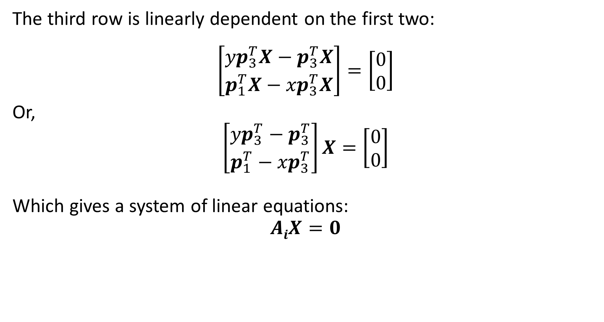
3-D Computer Vision
The third row is linearly dependent on the first two:
$$\left[\begin{matrix}{{yp}_{3}^{T}X−p}_{3}^{T}X \\ {p_{1}^{T}X−xp}_{3}^{T}X\end{matrix}\right]=\left[\begin{matrix}0 \\ 0\end{matrix}\right]$$
Or,
$$\left[\begin{matrix}{{yp}_{3}^{T}−p}_{3}^{T} \\ {p_{1}^{T}−xp}_{3}^{T}\end{matrix}\right]X=\left[\begin{matrix}0 \\ 0\end{matrix}\right]$$
Which gives a system of linear equations:
$$AiX=0$$

Slide 19
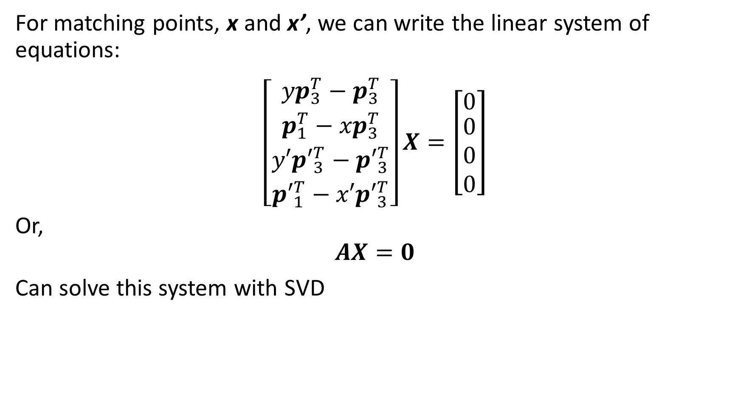
3-D Computer Vision
For matching points, x and x’, we can write the linear system of equations:
$$\left[\begin{matrix}{{yp}_{3}^{T}−p}_{3}^{T} \\ {p_{1}^{T}−xp}_{3}^{T} \\ \begin{matrix}{{y′p′}_{3}^{T}−p′}_{3}^{T} \\ {{p′}_{1}^{T}−x′p′}_{3}^{T}\end{matrix}\end{matrix}\right]X=\left[\begin{matrix}0 \\ \begin{matrix}0 \\ 0 \\ 0\end{matrix}\end{matrix}\right]$$
Or,
$$AX=0$$
Can solve this system with SVD

Slide 20
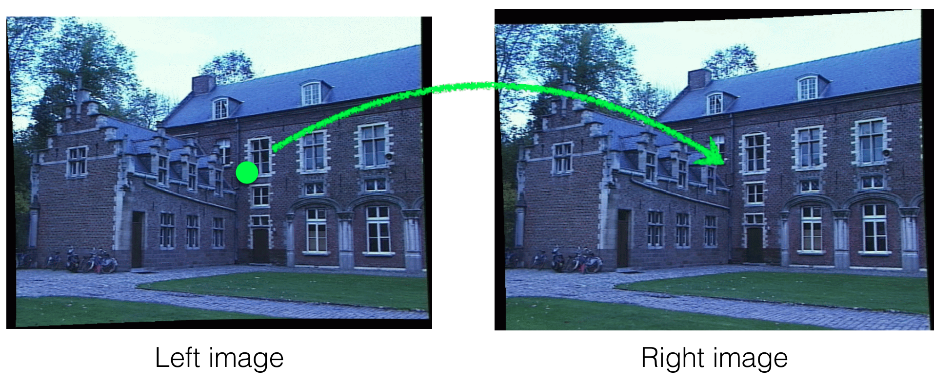
Finding Matching Points
We need to find matching points between the left and right images
Credit, Kris Kitani - CMU

Slide 21
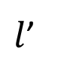
Finding Matching Points
We need to find matching points between the left and right images
Do we need to search entire pair of images for matching points?
No! We only need to search along the epipolar line, l’
Enforce the epipolar constraint
$$X$$
$$P$$
$$P′$$
$$x$$
$$x′$$
$$l$$
$l$’
$$o$$
$$e$$
$$e′$$
$$o′$$

Slide 22
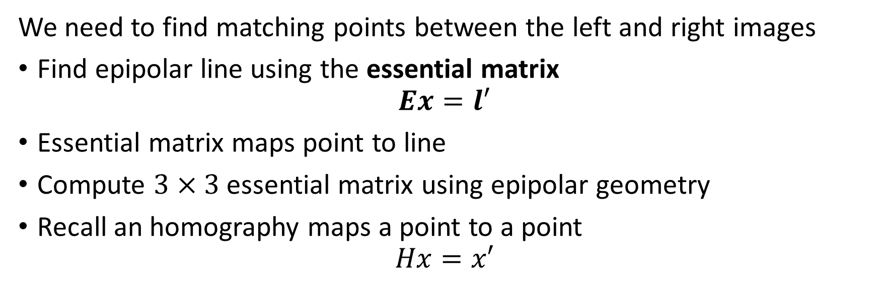
Finding Matching Points
We need to find matching points between the left and right images
Find epipolar line using the essential matrix
$$Ex=l′$$
Essential matrix maps point to line
Compute $3×3$ essential matrix using epipolar geometry
Recall an homography maps a point to a point
$$Hx=x′$$
$$X$$
$$P$$
$$P′$$
$$x$$
$$x′$$
$$l$$
$l$’
$$o$$
$$e$$
$$e′$$
$$o′$$

Slide 23

The Essential Matrix
Find epipolar line using the essential matrix
$$Ex=l′$$
Now, $x′⊥l′$, so the dot product ${x′}^{T}l^{′}=0$,
And,
$${x′}^{T}Ex={x′}^{T}l^{′}$$
$${x′}^{T}Ex=0$$
$$X$$
$$P$$
$$P′$$
$$x$$
$$x′$$
$$l$$
$l$’
$$o$$
$$e$$
$$e′$$
$$o′$$

Slide 24
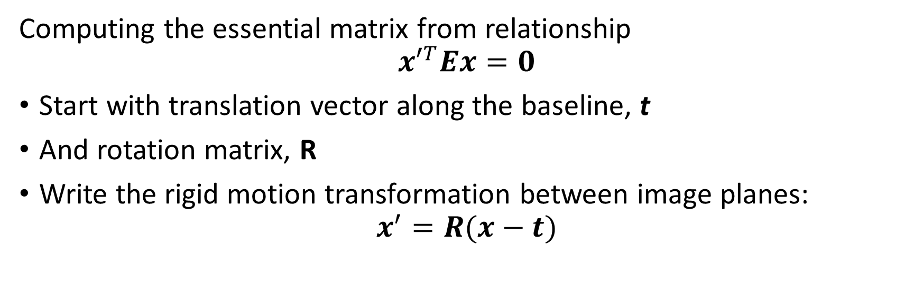

The Essential Matrix
Computing the essential matrix from relationship
$${x′}^{T}Ex=0$$
Start with translation vector along the baseline, t
And rotation matrix, R
Write the rigid motion transformation between image planes:
$$x^{′}=R(x−t)$$
$$X$$
$$P$$
$$P′$$
$$x$$
$$x′$$
$$l$$
$l$’
$$o$$
$$e$$
$$t$$
$$e′$$
$$o′$$

Slide 25
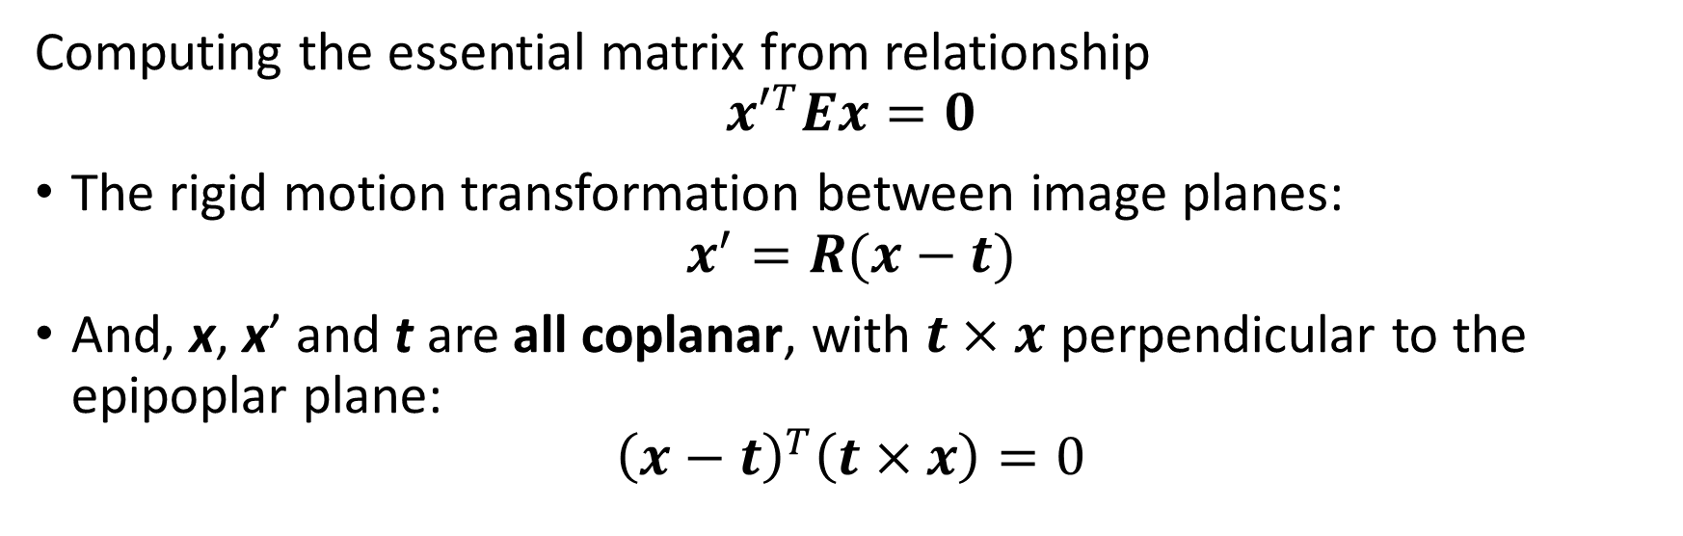
The Essential Matrix
Computing the essential matrix from relationship
$${x′}^{T}Ex=0$$
The rigid motion transformation between image planes:
$$x^{′}=R(x−t)$$
And, x, x’ and t are all coplanar, with $t×x$ perpendicular to the epipoplar plane:
$${\left(x−t\right)}^{T}\left(t×x\right)=0$$
$$X$$
$$P$$
$$P′$$
$$x$$
$$x′$$
$$l$$
$l$’
$$o$$
$$e$$
$$t$$
$$e′$$
$$o′$$

Slide 26
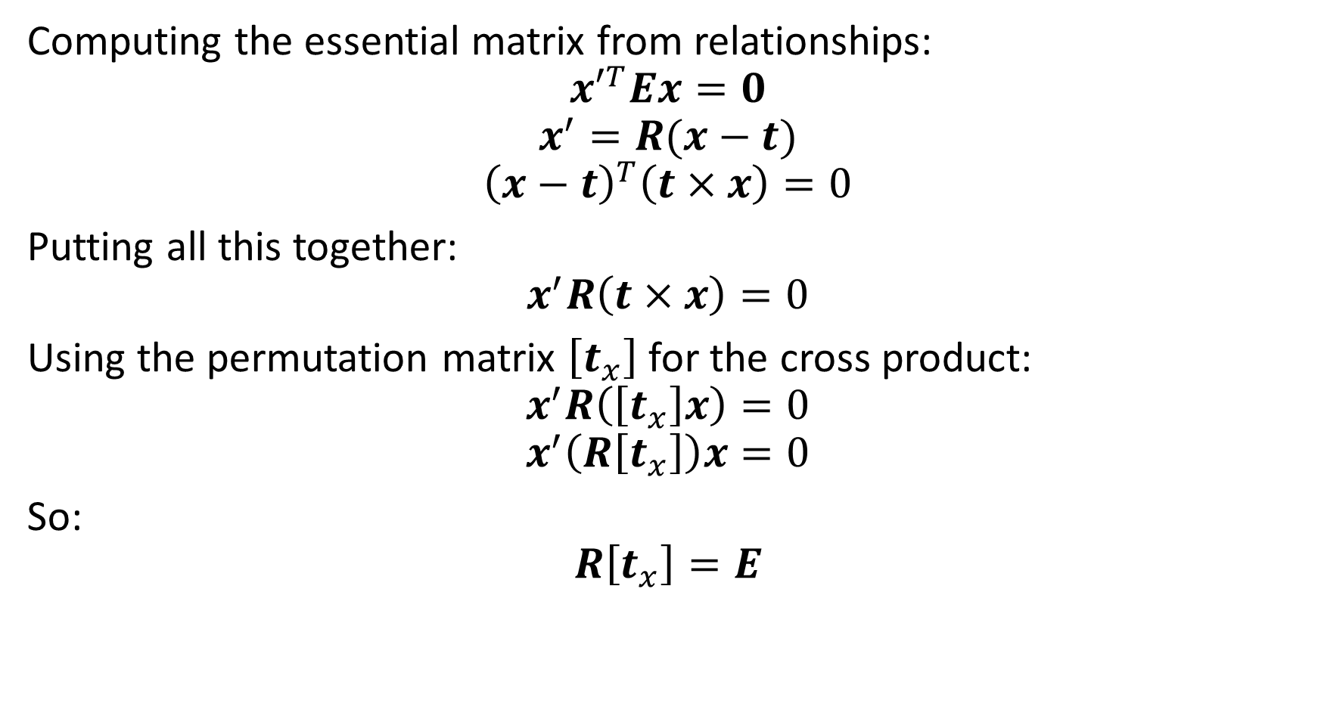
The Essential Matrix
Computing the essential matrix from relationships:
$${x′}^{T}Ex=0$$
$$x^{′}=R(x−t)$$
$${\left(x−t\right)}^{T}\left(t×x\right)=0$$
Putting all this together:
$$x^{′}R\left(t×x\right)=0$$
Using the permutation matrix $\left[t_{x}\right]$ for the cross product:
$$x^{′}R\left(\left[t_{x}\right]x\right)=0$$
$$x^{′}\left(R\left[t_{x}\right]\right)x=0$$
So:
$$R\left[t_{x}\right]=E$$

Slide 27
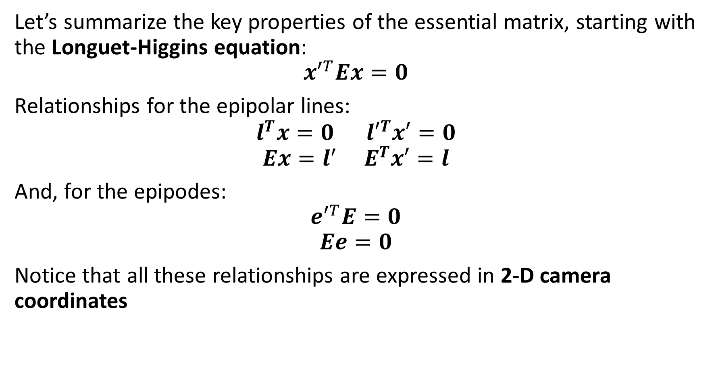
The Essential Matrix
Let’s summarize the key properties of the essential matrix, starting with the Longuet-Higgins equation:
$${x′}^{T}Ex=0$$
Relationships for the epipolar lines:
$$l^{T}x=0{ l′}^{T}x′=0$$
$$Ex=l^{′} E^{T}x′=l$$
And, for the epipodes:
$${e′}^{T}E=0$$
$$Ee=0$$
Notice that all these relationships are expressed in 2-D camera coordinates

Slide 28
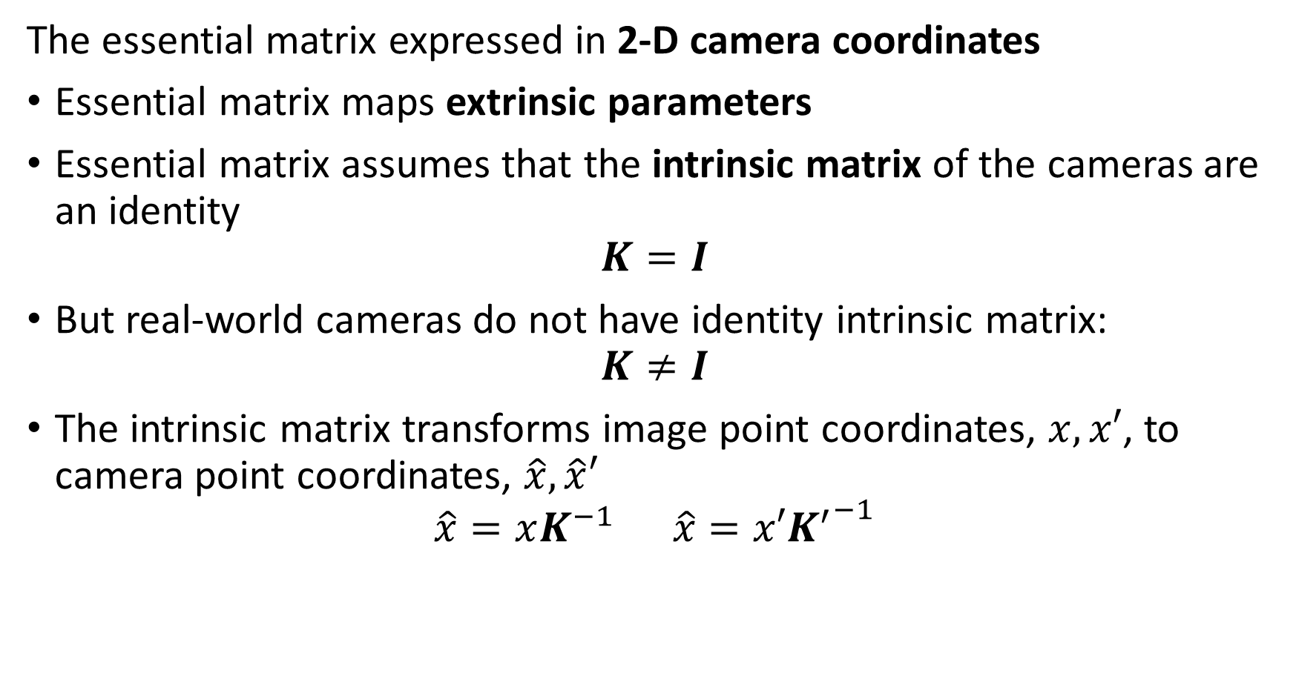
The Fundamental Matrix
The essential matrix expressed in 2-D camera coordinates
Essential matrix maps extrinsic parameters
Essential matrix assumes that the intrinsic matrix of the cameras are an identity
$$K=I$$
But real-world cameras do not have identity intrinsic matrix:
$$K≠I$$
The intrinsic matrix transforms image point coordinates, $x,x′$, to camera point coordinates, $\hat{x},\hat{x}′$
$$\hat{x}=xK^{−1} \hat{x}=x′{K^{′}}^{−1}$$

Slide 29
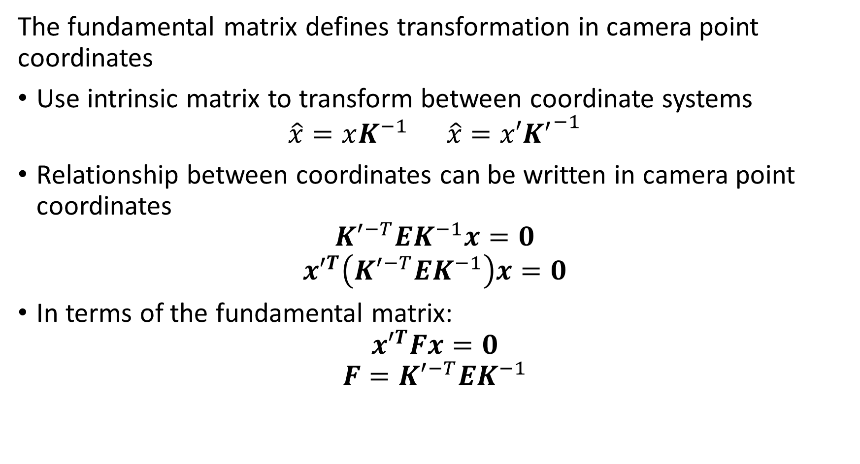
The Fundamental Matrix
The fundamental matrix defines transformation in camera point coordinates
Use intrinsic matrix to transform between coordinate systems
$$\hat{x}=xK^{−1} \hat{x}=x′{K^{′}}^{−1}$$
Relationship between coordinates can be written in camera point coordinates
$${K′}^{−T}EK^{−1}x=0$$
$${x′}^{T}\left({K′}^{−T}EK^{−1}\right)x=0$$
In terms of the fundamental matrix:
$${x′}^{T}Fx=0$$
$$F={K′}^{−T}EK^{−1}$$

Slide 30
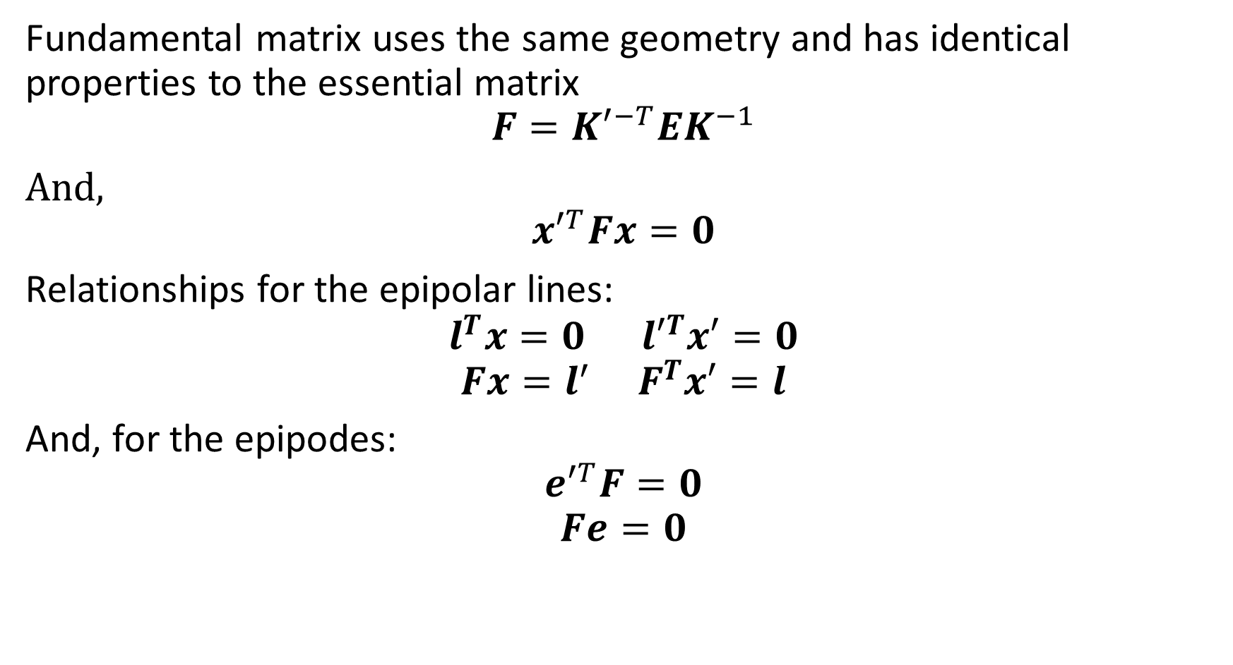
The Fundamental Matrix
Fundamental matrix uses the same geometry and has identical properties to the essential matrix
$$F={K′}^{−T}EK^{−1}$$
And,
$${x′}^{T}Fx=0$$
Relationships for the epipolar lines:
$$l^{T}x=0{ l′}^{T}x′=0$$
$$Fx=l^{′} F^{T}x′=l$$
And, for the epipodes:
$${e′}^{T}F=0$$
$$Fe=0$$

Slide 31
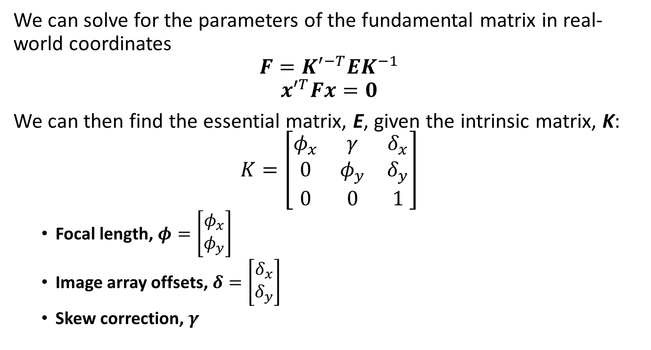
The Fundamental Matrix
We can solve for the parameters of the fundamental matrix in real-world coordinates
$$F={K′}^{−T}EK^{−1}$$
$${x′}^{T}Fx=0$$
We can then find the essential matrix, E, given the intrinsic matrix, K:
$$K=\left[\begin{matrix}φ_{x} & γ & δ_{x} \\ 0 & φ_{y} & δ_{y} \\ 0 & 0 & 1\end{matrix}\right]$$
Focal length, $φ=\left[\begin{matrix}φ_{x} \\ φ_{y}\end{matrix}\right]$
Image array offsets, $δ=\left[\begin{matrix}δ_{x} \\ δ_{y}\end{matrix}\right]$
Skew correction, $γ$

Slide 32
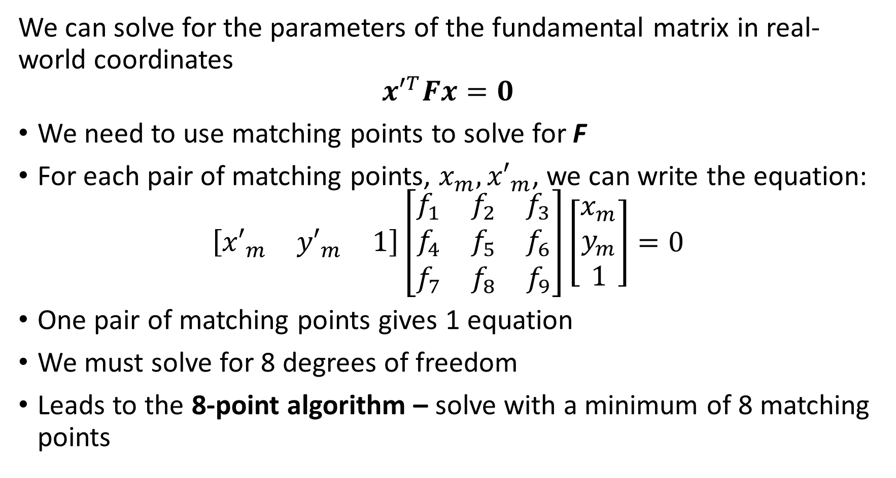
The Fundamental Matrix
We can solve for the parameters of the fundamental matrix in real-world coordinates
$${x′}^{T}Fx=0$$
We need to use matching points to solve for F
For each pair of matching points, $x_{m},{x′}_{m}$, we can write the equation:
$$\left[\begin{matrix}{x′}_{m} & {y′}_{m} & 1\end{matrix}\right]\left[\begin{matrix}f_{1} & f_{2} & f_{3} \\ f_{4} & f_{5} & f_{6} \\ f_{7} & f_{8} & f_{9}\end{matrix}\right]\left[\begin{matrix}x_{m} \\ y_{m} \\ 1\end{matrix}\right]=0$$
One pair of matching points gives 1 equation
We must solve for 8 degrees of freedom
Leads to the 8-point algorithm – solve with a minimum of 8 matching points

Slide 33
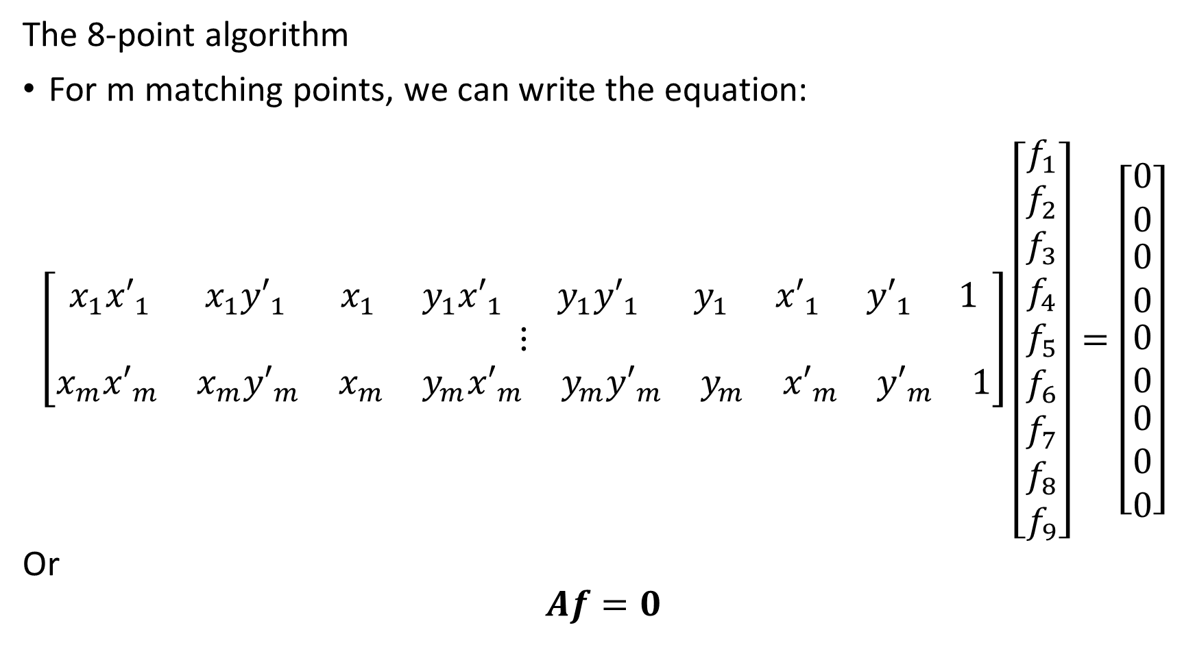
The Fundamental Matrix
The 8-point algorithm
For m matching points, we can write the equation:
$$\left[\begin{matrix}\begin{matrix}x_{1}{x′}_{1} & {x_{1}y′}_{1} & \begin{matrix}x_{1} & {y_{1}x′}_{1} & \begin{matrix}{y_{1}y′}_{1} & y_{1} & \begin{matrix}{x′}_{1} & {y′}_{1} & 1\end{matrix}\end{matrix}\end{matrix}\end{matrix} \\ ⋮ \\ \begin{matrix}x_{m}{x′}_{m} & {x_{m}y′}_{m} & \begin{matrix}x_{m} & {y_{m}x′}_{m} & \begin{matrix}{y_{m}y′}_{m} & y_{m} & \begin{matrix}{x′}_{m} & {y′}_{m} & 1\end{matrix}\end{matrix}\end{matrix}\end{matrix}\end{matrix}\right]\left[\begin{matrix}f_{1} \\ f_{2} \\ \begin{matrix}f_{3} \\ f_{4} \\ \begin{matrix}f_{5} \\ \begin{matrix}f_{6} \\ f_{7} \\ \begin{matrix}f_{8} \\ f_{9}\end{matrix}\end{matrix}\end{matrix}\end{matrix}\end{matrix}\right]=\left[\begin{matrix}0 \\ 0 \\ \begin{matrix}0 \\ 0 \\ \begin{matrix}0 \\ 0 \\ \begin{matrix}0 \\ 0 \\ 0\end{matrix}\end{matrix}\end{matrix}\end{matrix}\right]$$
Or
$$Af=0$$

Slide 34
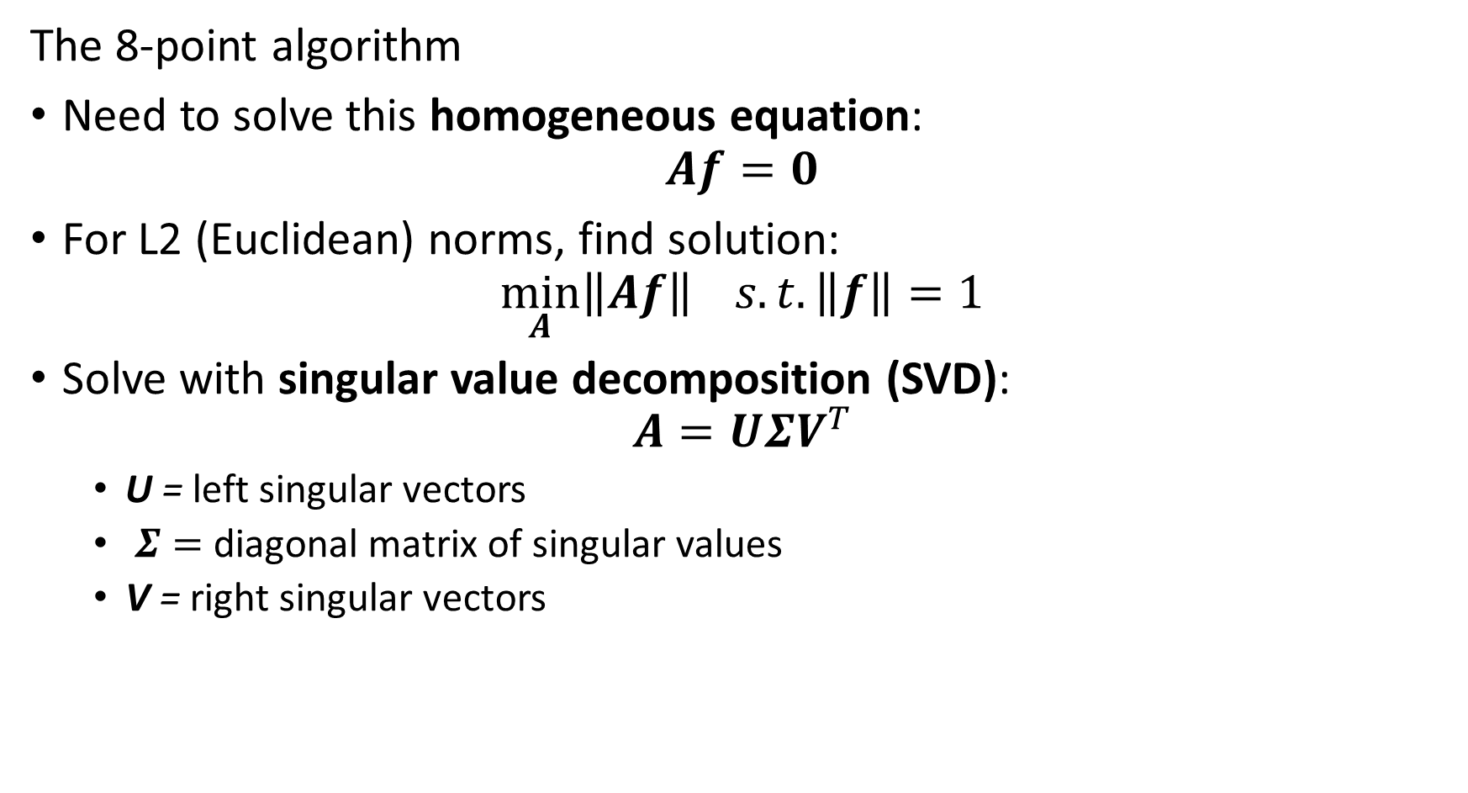
The Fundamental Matrix
The 8-point algorithm
Need to solve this homogeneous equation:
$$Af=0$$
For L2 (Euclidean) norms, find solution:
$$\min_{A}\left\|Af\right\| s.t. \left\|f\right\|=1$$
Solve with singular value decomposition (SVD):
$$A=UΣV^{T}$$
U = left singular vectors
$Σ=$ diagonal matrix of singular values
V = right singular vectors

Slide 35
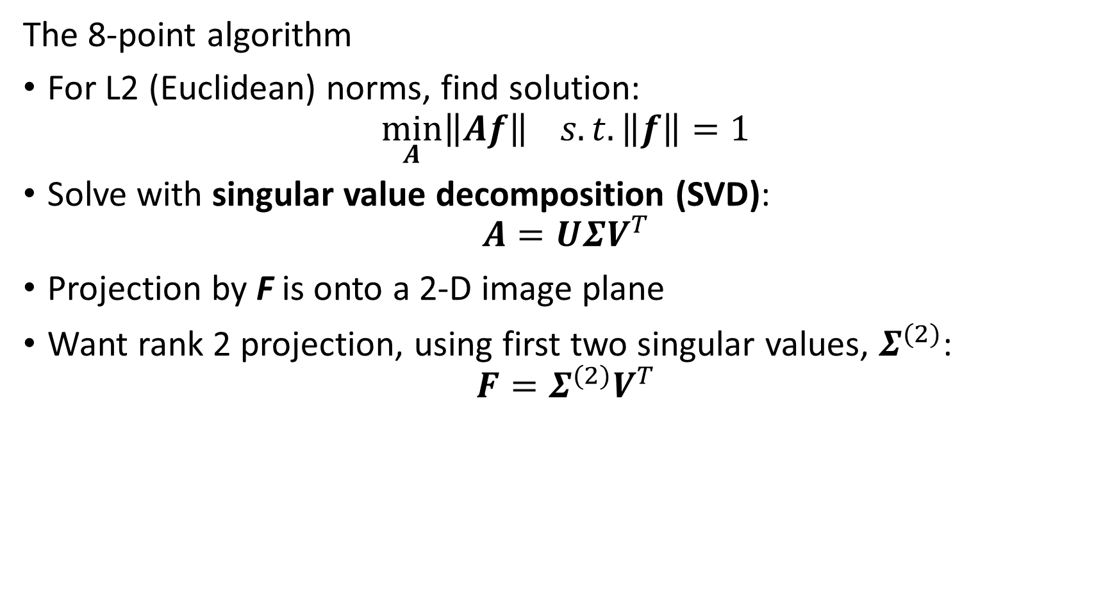
The Fundamental Matrix
The 8-point algorithm
For L2 (Euclidean) norms, find solution:
$$\min_{A}\left\|Af\right\| s.t. \left\|f\right\|=1$$
Solve with singular value decomposition (SVD):
$$A=UΣV^{T}$$
Projection by F is onto a 2-D image plane
Want rank 2 projection, using first two singular values, $Σ^{(2)}$:
$$F=Σ^{(2)}V^{T}$$

Slide 36
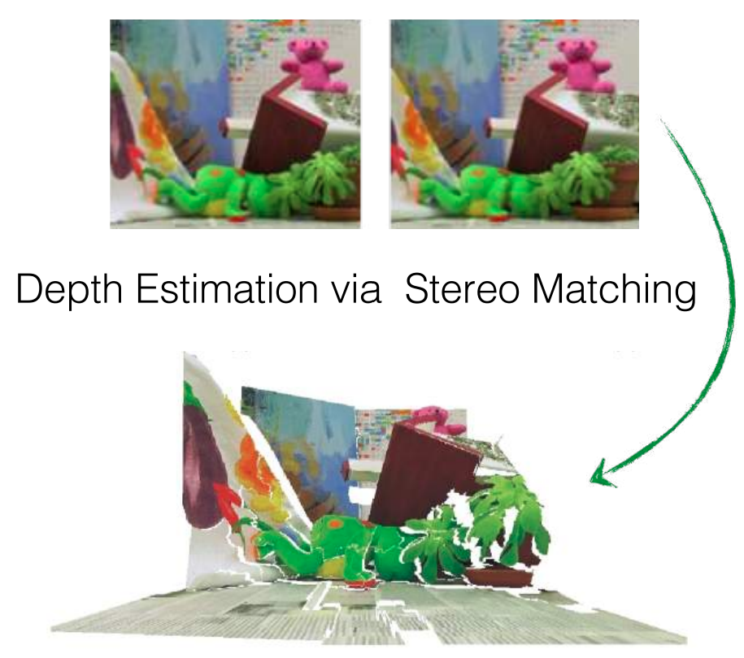
Stereo Depth Estimation
Example: Depth estimation from stereo pair matching

Slide 37
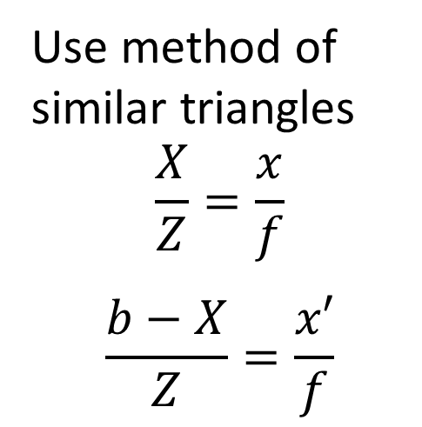
Stereo Depth Estimation
To create a 3-D scene must rectify the cameras
When cameras are rectified the image planes are coplanar
With rectified images can triangulate distance to each point on the image plane
Use method of similar triangles
$$\frac{X}{Z}=\frac{x}{f}$$
$$\frac{b−X}{Z}=\frac{x′}{f}$$
X
Z
x
x’
f
Image Planes
O
O’
Baseline, b

Slide 38
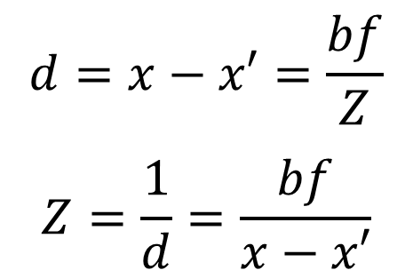
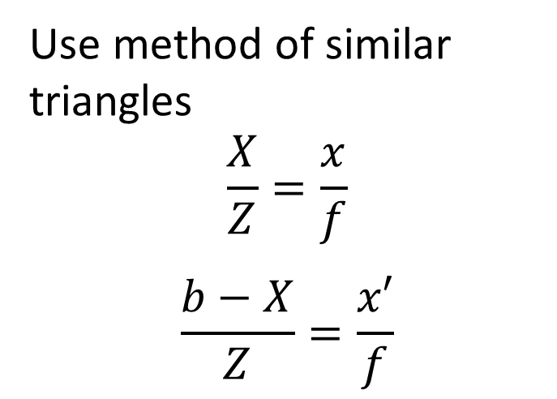
Stereo Depth Estimation
Use disparity to compute depth from rectified images
Depth, Z, is the inverse of disparity, d
Use method of similar triangles
$$\frac{X}{Z}=\frac{x}{f}$$
$$\frac{b−X}{Z}=\frac{x′}{f}$$
$$d=x−x′=\frac{bf}{Z}$$
$$Z=\frac{1}{d}=\frac{bf}{x−x′}$$
X
Z
x
x’
f
Image Planes
O
O’
Baseline, b

Slide 39
Stereo Depth Estimation
Use disparity to compute depth from rectified images
Depth, Z, is the inverse of disparity, d
Disparity, d, is proportional to the baseline, b
Sufficient baseline is required to accurately estimate Z
Disparity, d, is inversely proportional to Z
Nearer distances are estimated more accurately
$$d=x−x′=\frac{bf}{Z}$$
$$Z=\frac{1}{d}=\frac{bf}{x−x′}$$
X
Z
x
x’
f
Image Planes
O
O’
Baseline, b

Slide 40
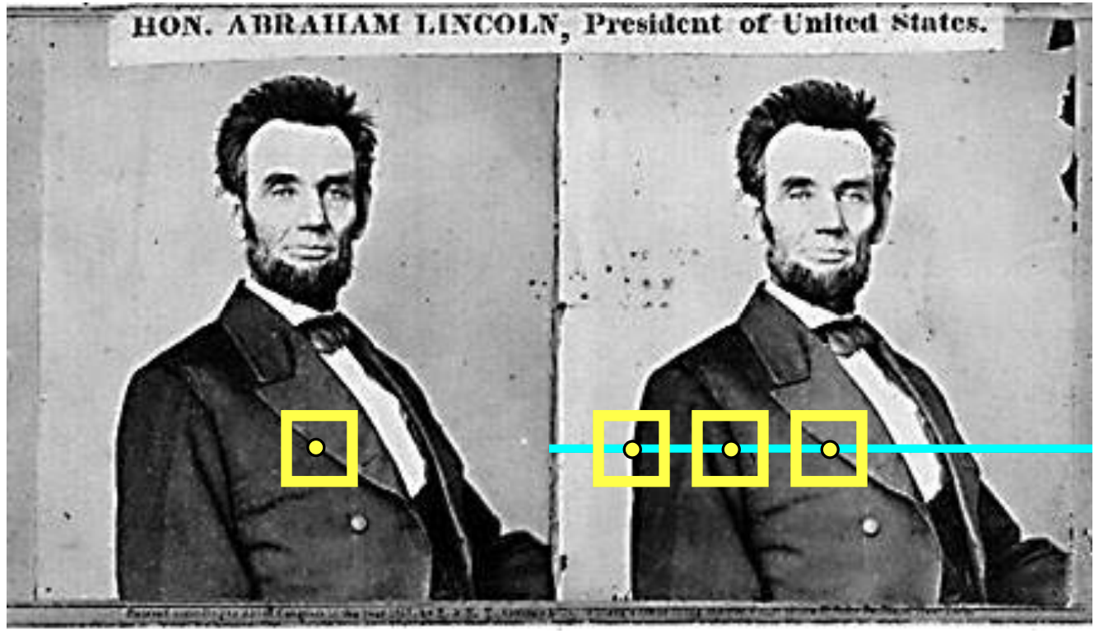
Stereo Depth Estimation
How can we create a high resolution depth map of a scene?
Start with rectified images which have horizontal epipolar lines
For each pixel in left image:
Find horizontal epipolar line on right image
Search epipolar line for matches
Compute disparity and depth

Slide 41
Stereo Depth Estimation
How do we find matching pixel pairs?
Many methods are used for template matching
Locally scaled sum of absolute differences (LSSAD), normalized cross correlation, etc.
Is a speed-accuracy trade-off
State of the art moving to CNN architectures, e.g. Shamsafar, et. al., 2021

Slide 42

Rectification of images
Rectified images have horizontal epipolar lines
Rectified image planes are coplanar
When epipolar line is horizontal where is the epipode?
Epipolar lines are image plane
Epipode is at $∞$!
X
x
x’
Baseline, t

Slide 43

Rectification of images
How do we rectify images?
Image planes are coplanar: $R=I$, the identity
Baseline is coplanar and horizontal: $t=\left[T,0,0\right]$
X
x
x’
Baseline, t

Slide 44
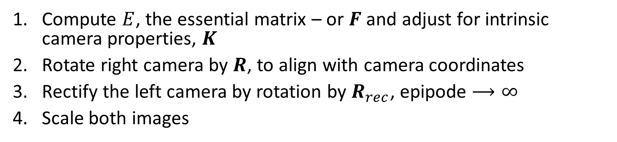
Rectification of images
How do we rectify images?
Compute $E$, the essential matrix – or $F$ and adjust for intrinsic camera properties, $K$
Rotate right camera by $R$, to align with camera coordinates
Rectify the left camera by rotation by $R_{rec}$, epipode $⟶∞$
Scale both images
X
x
x’
Baseline, t

Slide 45
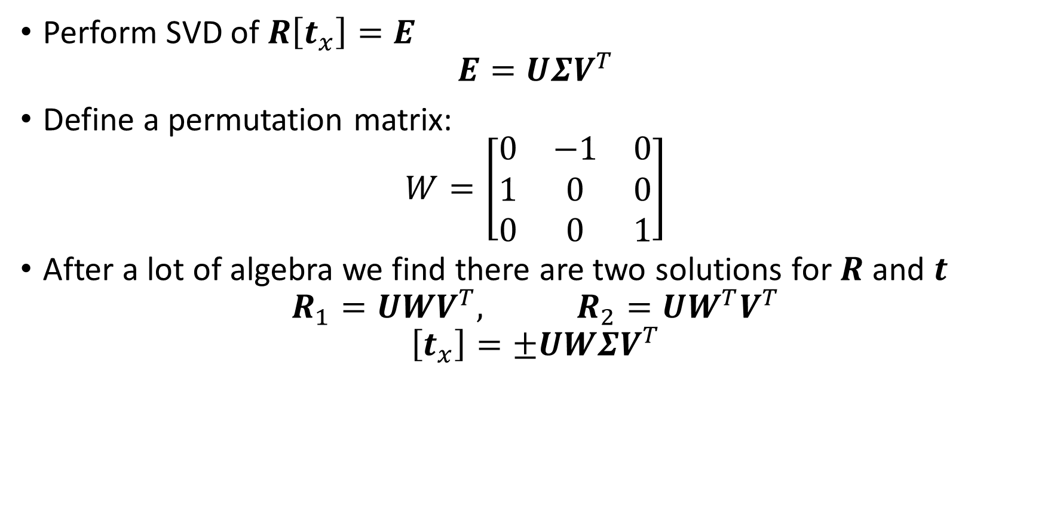
Rectification of images
How do we find $R$ and $t$ given $E$?
Perform SVD of $R\left[t_{x}\right]=E$
$$E=UΣV^{T}$$
Define a permutation matrix:
$$W=\left[\begin{matrix}0 & −1 & 0 \\ 1 & 0 & 0 \\ 0 & 0 & 1\end{matrix}\right]$$
After a lot of algebra we find there are two solutions for $R$ and $t$
$$R_{1}=UWV^{T}, R_{2}=UW^{T}V^{T}$$
$$\left[t_{x}\right]=±UWΣV^{T}$$

Slide 46
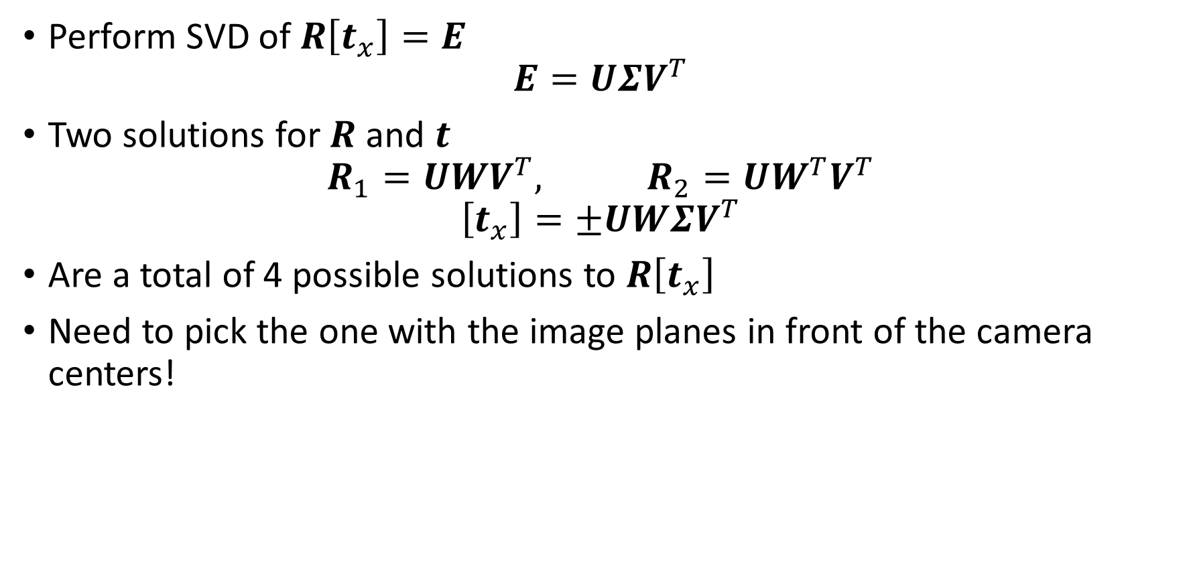
Rectification of images
How do we find $R$ and $t$ given $E$?
Perform SVD of $R\left[t_{x}\right]=E$
$$E=UΣV^{T}$$
Two solutions for $R$ and $t$
$$R_{1}=UWV^{T}, R_{2}=UW^{T}V^{T}$$
$$\left[t_{x}\right]=±UWΣV^{T}$$
Are a total of 4 possible solutions to $R\left[t_{x}\right]$
Need to pick the one with the image planes in front of the camera centers!

Slide 47
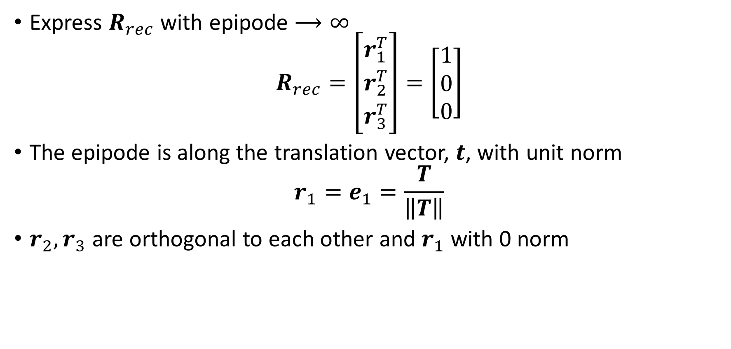
Rectification of images
How can we set the epipode $⟶∞$?
Express $R_{rec}$ with epipode $⟶∞$
$$R_{rec}=\left[\begin{matrix}r_{1}^{T} \\ r_{2}^{T} \\ r_{3}^{T}\end{matrix}\right]=\left[\begin{matrix}1 \\ 0 \\ 0\end{matrix}\right]$$
The epipode is along the translation vector, $t$, with unit norm
$$r_{1}=e_{1}=\frac{T}{\left\|T\right\|}$$
$r_{2},r_{3}$ are orthogonal to each other and $r_{1}$ with 0 norm

Slide 48
3-D Computer Vision
Summary
What methods can we use for 3-D CV models?
Epipolar geometry
Properties of the essential matrix
Solving for the fundamental matrix
Stereo depth estimation
Rectification of images

